Slide 1
Presentation On ‘KANFO’ Business Intelligence

Slide 2
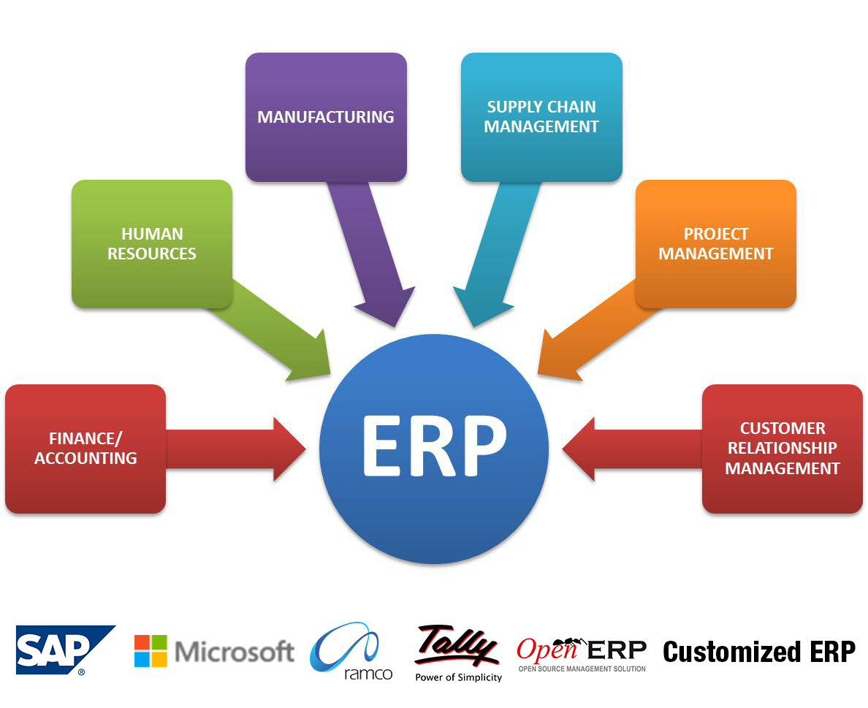
Current Scenario

Slide 3
Market Survey :
A survey conducted to know utilization of IT in business organizations reveals following results,
70 % companies uses ERP as integrated Data Entry Module.
Most companies check their outstanding, payment , receipt and inventory.
60-70 % companies avoid to take Maintenance , HR ,Controlling module. They are satisfied only with Purchase ,Sales ,Inventory and Sales.
Lots of reports are there in software but only 20% is use effectively.
Many companies are aware about business process loopholes, but no activity is undertaken to control them.
Company director /owner are usually busy with their future expansion.
Its not possible to check your business process control reports daily.

Slide 4
What is ‘Kanfo’ Business Intelligence (BI)?
BI is combination of various business processes, process controlling and business data analysis.
BI help to find loophole of your business & processes
BI helps to put alerts about loopholes & generate auto daily/weekly/monthly MIS reports as per designation wise requirement.
BI makes a system for your business which runs on auto mode.
BI tools integrate with Data Integration, Data processing engine, Data Formatting, Task Management System (TMS), Business Monitoring, Report Engine etc.

Slide 5
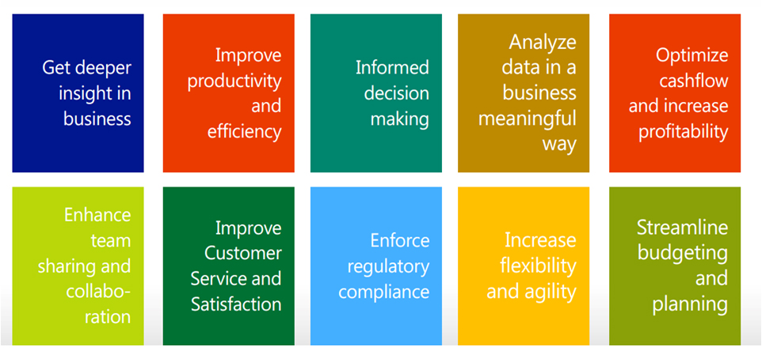
The benefits are obvious
Web.: www.kanfotechnology.com Email.: info@kanfotechnology.com

Slide 6
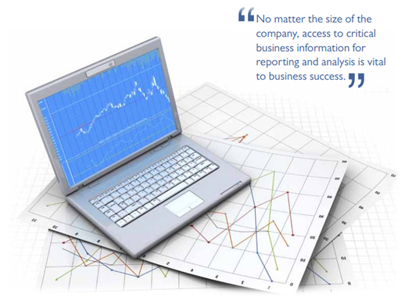
How ‘Kanfo’ BI works?
‘Kanfo’ BI is extension of your existing ERP or other IT system. It extract the required data from existing IT system and combine it to represent it in a meaningful way to enhance ‘managerial effectiveness’ and ‘management control’
‘Kanfo’ BI performs & integrates
Data Integration
Data processing engine
Data Mining
Task Management System
Work flow management
Scheduling
Process Controlling
Report Engine
Document sharing
Reminders

Slide 7
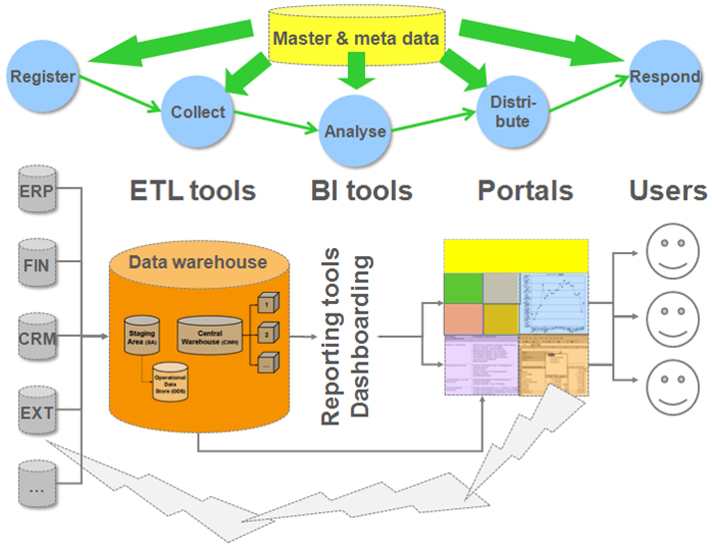

Slide 8
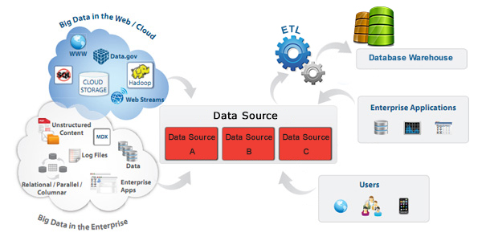
Business Intelligence : How it Works ?
Data Integration Engine :
This engine integrate your different DB and synchronized them with new central DB.
Engine convert different database format to single format.

Slide 9
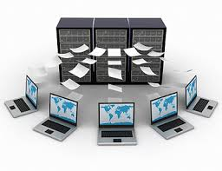
Business Intelligence : How it Works ?
Data processing engine
This engine process your data and create parallel database.
This engine use some SQL tools which tune up your DB and increase performance for BI analysis.

Slide 10
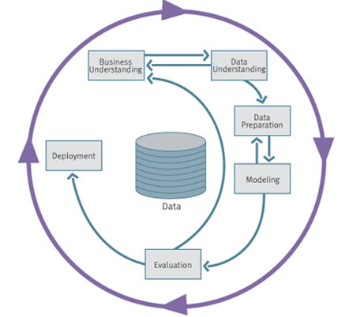
Business Intelligence : How it Works ?
Data Mining
Data mining engine process your integrated DB as per business analysis requirement.
Data mining engine generate tables with data which raw material for report engine.

Slide 11
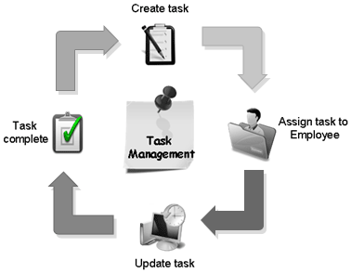
Business Intelligence : How it Works ?
Task Management System (TMS)
TMS help to organized your business workflow.
TMS give option to handle non operational process like client Complain, CRM , Follow up activity.
TMS put system which guide and insist your work person to perform operations on time bound.
TMS improve your employee productivity and performance.
TMS work with Data mining engine and report engine.

Slide 12
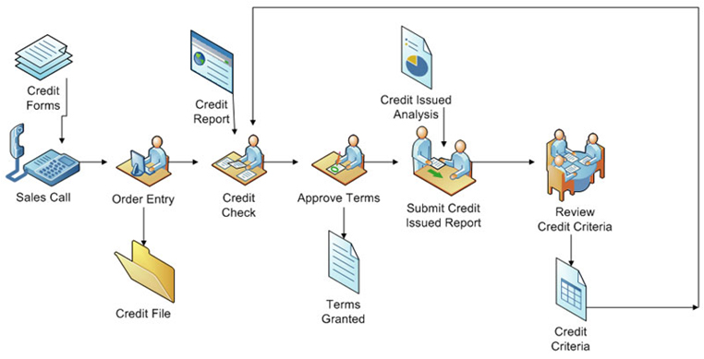
Business Intelligence : How it Works ?
Work flow management (WFM)
WFM guide our work to execute its work .
WFM is designed with deeper analysis of different steps to execute a specific task.
No confusion in workflow as to how the person will perform operation.

Slide 13
Business Intelligence : How it Works ?
Scheduling
Scheduling will auto execute and generate task and reports for managers or management as per predefined logic and order.
User don’t need to ask for reports every time to his down line or take reports from software .
This will help you decrease your ERP user license.

Slide 14
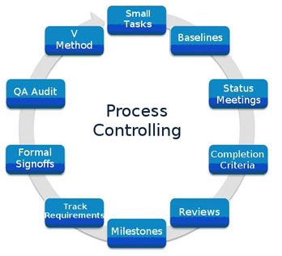
Business Intelligence : How it Works ?
Process Controlling
This engine put control on your business process and generate alerts if system work out of scope.
This engine continuously analyze your data and generate tasks or alerts.
Process control engine is very helpful to manage following module
Long time outstanding
Maintenance module
Inventory controlling
Tax return submission
etc

Slide 15
Business Intelligence : How it Works ?
Report Engine
Presentation of your data analysis in numerical or graphical format.
Report engine come in two different ways.
Statistical data presentation on PDF format.
Active data presentation with filters ,sorting ,customized formatting etc on web link.

Slide 16
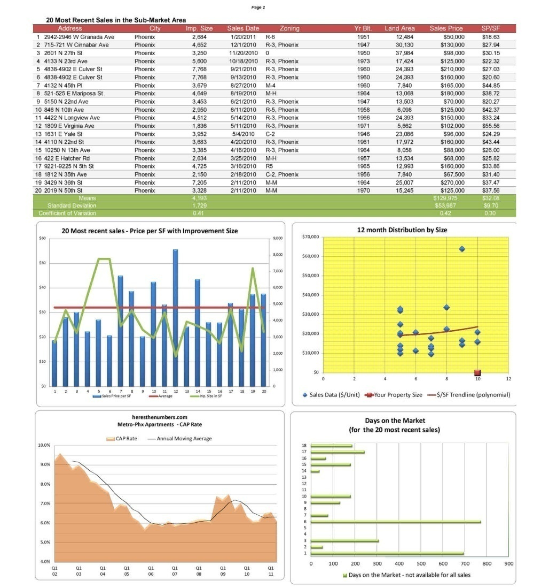
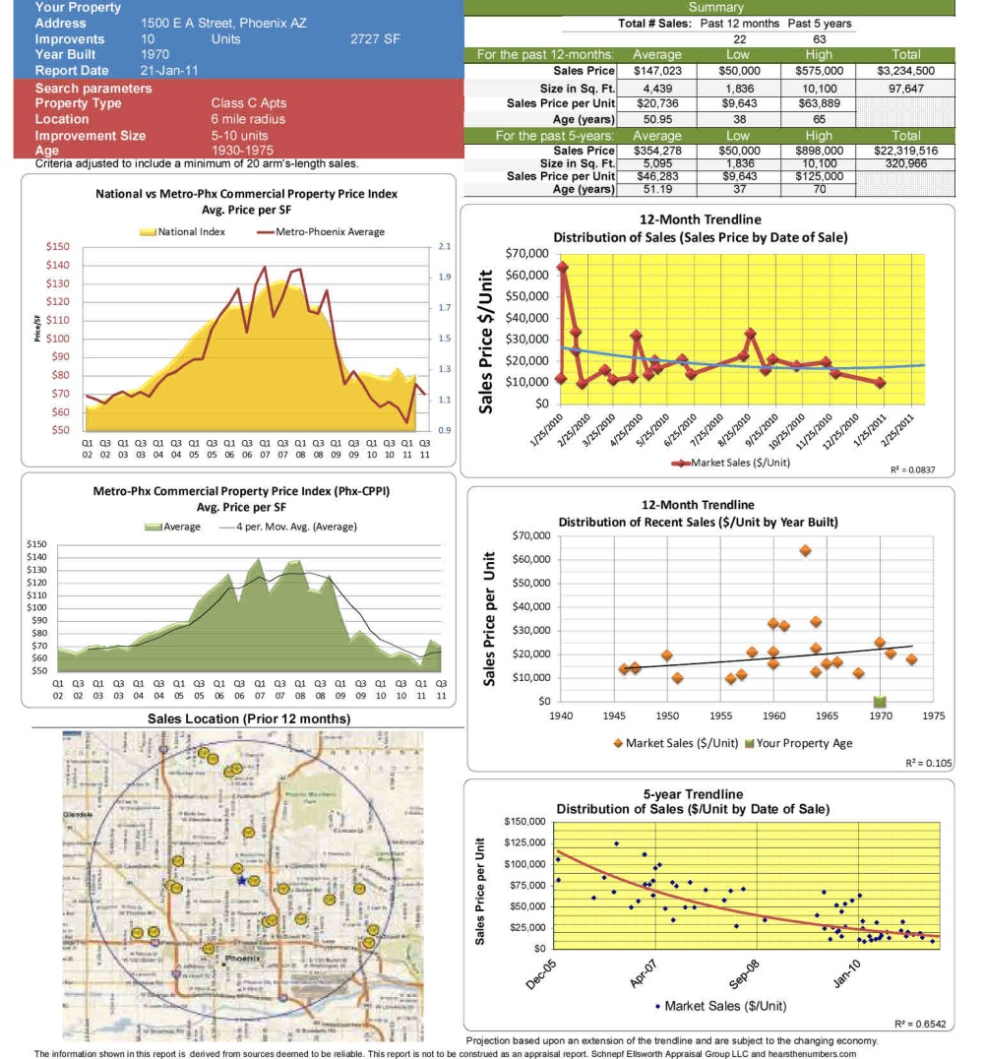
Dynamic PDF Reports

Slide 17
Reminders
User can set his own or other reminders.
Reminders can be set daily/weekly /monthly etc
Reminders give alerts by SMS and Email.

Slide 18
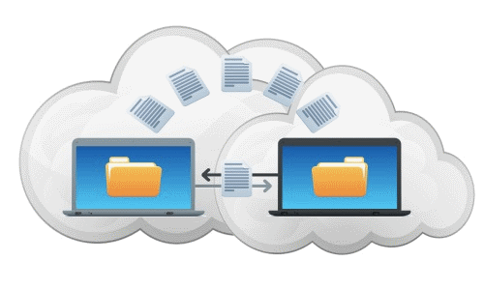
Document Sharing
User can shared documents with others in highly security environment.
Shared document only access with authenticated users.

Slide 19
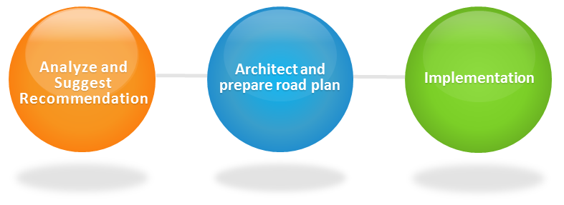
Business Intelligence Implementations Plan
Analyze your business process and data .
Make a list of reports ,alerts and schedules which want to achieve BI.
Implement Data Engine.
Set TMS, Scheduling, Control system etc.
Verifying reports format and data consistency.
Test Scheduling and control system .
Training.
Delivery.

Slide 20
For more information of ‘kanfo’ Business Intelligence tool.
Contact Us
Mobile :- +91 98252 74064
Email :- info@kanfotechnology.com
Website :- www.kanfotechnology.com
Facebook : facebook.com/kanfotechnology
Twitter :- twitter.com/kanfotechnology
Linkedin :- linkedin.com/in/kanfotechnology

